Slide 1
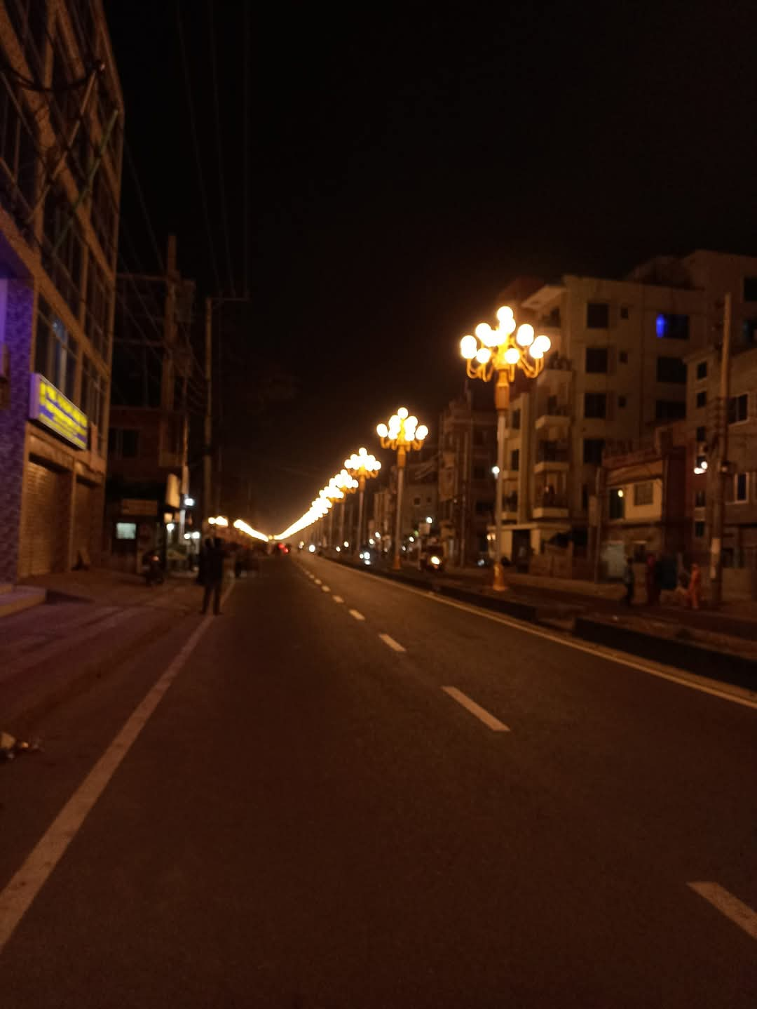
Smart City Road Lights
A Smart, Energy-Efficient Street Lighting System
https://github.com/Thunder10046/Smart_City_road_lights
CSE 3200
Software Development Project II
Presented By
Shah Ahmed Raad
Roll : 2003042
Dept of CSE | RUET

Slide 2
Addressing Inefficient Street Lighting
The Problem
Solution
Current road lights, especially in Rajshahi City, waste electricity by remaining on continuously, lacking dynamic adaptation to automation or road activity. This necessitates an intelligent system that balances visibility and energy usage.
Here, the proposal is to use a smart, energy-efficient street lighting system that dynamically adjusts brightness (automatically) based on sunlight and real-time object detection, optimizing both visibility and energy consumption.

Slide 3



Project Objectives
Cost-Effectiveness
Energy-Saving
Smart Lighting
Develop a lighting system that is affordable to implement and maintain.
Minimize electricity consumption through intelligent control mechanisms.
Implement a system that adapts to environmental conditions and user needs.

Slide 4
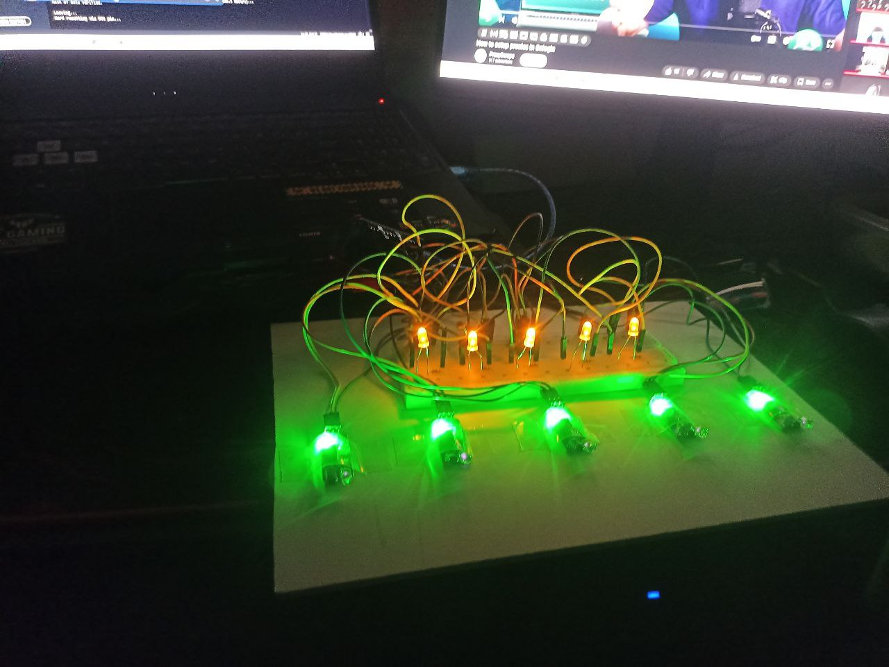



Core Features of the Smart Lighting System
Day/Night Detection
Motion-Based Control
PWM Light Dimming
Automatic detection using LDR (Light Dependent Resistor).
Utilizing IR sensors for real-time object detection.
PWM-based light dimming and brightening for smooth control.
The smart lighting system incorporates automatic day/night detection using LDR sensors, motion-based control via IR sensors, and PWM-based light dimming for efficient energy management.

Slide 5
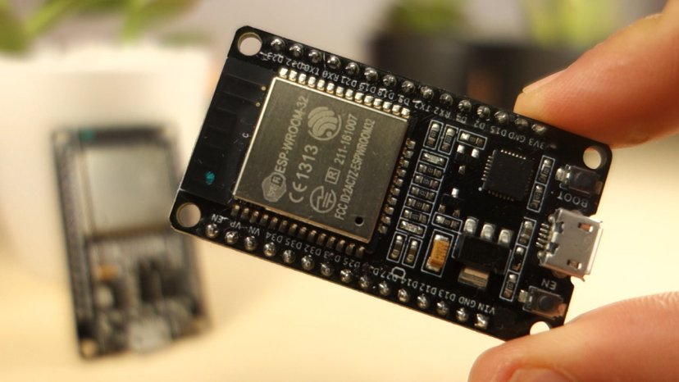
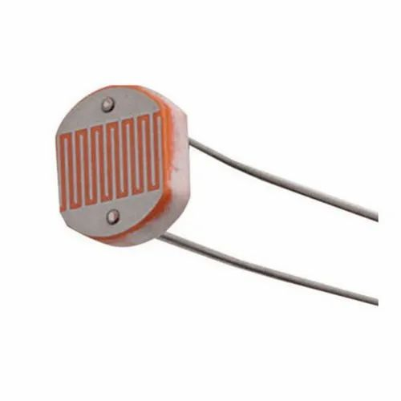
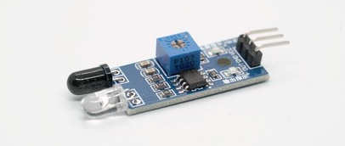

Hardware Components Overview
ESP32 Microcontroller
The brain of the system, responsible for processing sensor data and controlling LEDs.
LDR Sensor
Detects ambient light levels to determine day or night.
IR Sensors
Detect motion of vehicles or pedestrians.
LEDs
Provide illumination, with brightness controlled by PWM.

Slide 6



System Working Principle
Daytime
All lights remain OFF to conserve energy.
Nighttime (Default)
Lights stay DIM to provide minimal illumination.
Motion Detected
Affected LEDs become BRIGHT to enhance visibility.
During daytime, all lights are off. At night, lights default to a dim setting, brightening only when motion is detected by the IR sensors, ensuring efficient energy use and enhanced visibility.

Slide 7
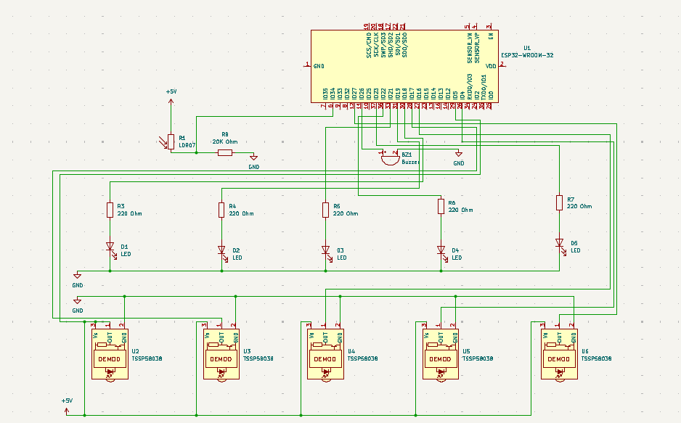
Implementation (Schematic)

Slide 8
Implementation (Code)
void loop() {
int ldrValue = analogRead(LDR);
bool isNight = (ldrValue < 1000);
if (!isNight) {
// DAY MODE: Turn off all LEDs
Serial.println("Day Mode: All LEDs OFF");
for (int i = 0; i < 5; i++) {
ledcWrite(i, 0);
}
nightModePrev = false; // reset flag
}
else {
// NIGHT MODE
if (!nightModePrev) {
Serial.println("Night Mode ON → Buzzing once...");
digitalWrite(buzzer, HIGH);
delay(800); // Buzz for 1.5s
digitalWrite(buzzer, LOW);
nightModePrev = true;
// now we won't buzz again until next day
}
for (int i = 0; i < 5; i++) {
int sensor_status = digitalRead(IRSensors[i]);
if (sensor_status == HIGH) {
// No obstacle for this sensor, keep LED dim
ledcWrite(i, dimBrightness);
Serial.print("LED "); Serial.print(i); Serial.println(" Dim (No Obstacle)");
}
else {
// Obstacle detected → instantly brighten corresponding LED
Serial.print("Obstacle at IR "); Serial.print(i); Serial.println(" → Bright LED");
ledcWrite(i, fullBrightness);
}
}
}
delay(100); // Prevent overwhelming the loop
}
int LDR = 34; // LDR pin
int LedPins[] = {18, 19, 21, 22, 23}; // LED pins
int IRSensors[] = {5, 17, 16, 4, 27}; // IR sensor pins
int dimBrightness = 64;
int fullBrightness = 255;
int buzzer = 26;
const int pwmFreq = 5000;
const int pwmResolution = 8;
bool nightModePrev = false; // to detect transition
void setup() {
Serial.begin(115200);
pinMode(buzzer, OUTPUT);
for (int i = 0; i < 5; i++) {
pinMode(LedPins[i], OUTPUT);
pinMode(IRSensors[i], INPUT);
ledcSetup(i, pwmFreq, pwmResolution);
ledcAttachPin(LedPins[i], i);
}
}

Slide 9
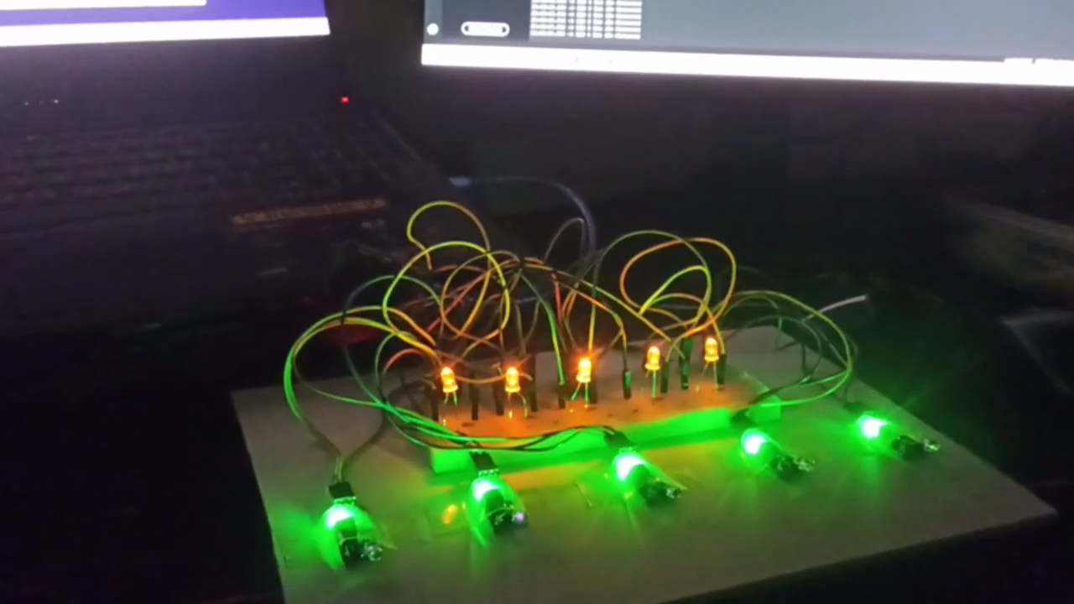
Simulation

Slide 10



Key Benefits of the Smart Lighting System
Reduced Consumption
Significant reduction in energy consumption.
Smart Infrastructure
Contribution to future smart city initiatives.
Scalable and Modular
Easy to scale and adapt to different environments.
The smart lighting system offers reduced energy consumption, contributes to smart infrastructure development, and is scalable and modular, making it a cost-effective and sustainable solution for city lights. In Rajshahi, we see lights are used inconveniently. By this implementation, energy can be saved and wastage is reduced. Electricity is used in convenient manner, also in an intelligent way.

Slide 11





Future Enhancements
Solar Integration
Solar panel integration for off-grid operation.
Cloud Monitoring
Cloud-based monitoring with Arduino Cloud/IoT dashboards.
Remote Alerts
GSM/LoRa integration for remote alerts.
Adaptive Brightness
Adaptive brightness based on vehicle speed/density.

Slide 12
Conclusion:
This smart city road lights project represents a step toward sustainable, intelligent city lighting by combining embedded systems, sensors, and automation. It is ready for future expansion and real-world deployment, offering a scalable and cost-effective solution for modern cities.

